Slide 1



06/01/2020
Vocational School of Computer Programming and Innovations
AUTHORS:
Ivan Mihaylov
Boris Savov
Stephan Stratev
Yavor Karakolev
Viktor Kavaldzhiev

Slide 2
Topic

Slide 3
Purposes

Slide 4
Milestones in the realization
Deciding what to do
Coding
Doing a presentation
Writing a documentation

Slide 5



Used applications

Slide 6
Level of complexity

Slide 7
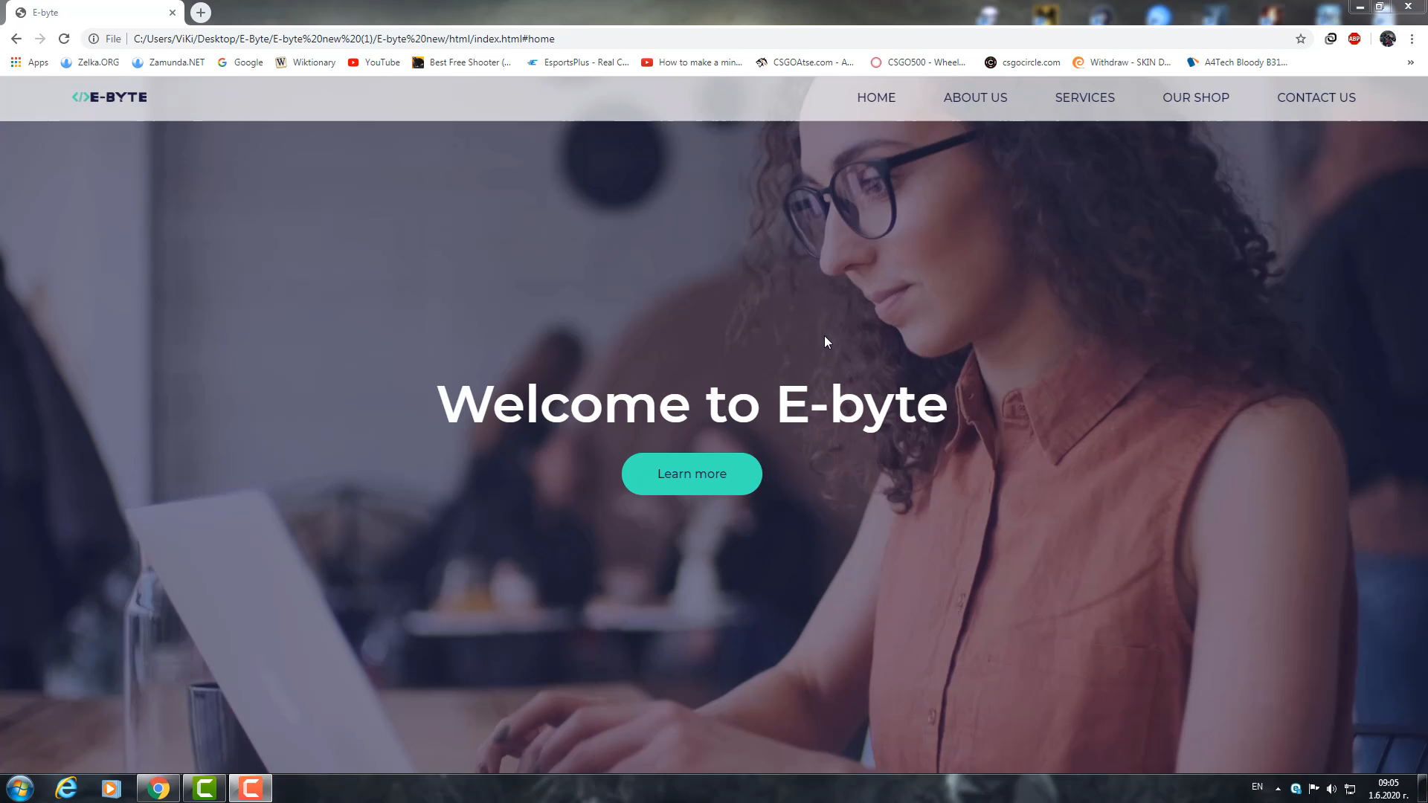

Slide 8
Conclusion

Slide 9

Q & A

Slide 10
Thanks for your attention!

